Slide 1

LUCA CAIVANO
OCTOBER 2022
Reduced Fluid-Structure Interaction and
non-Newtonian models of blood flows for simulating the aortic valve
Author: Luca Caivano
Advisor: Prof. Luca Dedè
Co-advisors: Dr. Ivan Fumagalli, Michele Bucelli
Academic year: 2021-2022

Slide 2
INTRODUCTION
Clinical motivations
Goal of the thesis
MATHEMATICAL MODELS
Reduced FSI model
Non-Newtonian model
Numerical method
NUMERICAL RESULTS
Numerical setting
Healthy valve
Pathological cases
Newtonian vs non-Newtonian
CONCLUSIONS
LUCA CAIVANO
OCTOBER 2022
1

Slide 3

OCTOBER 2022
Introduction
LUCA CAIVANO

Slide 4

LUCA CAIVANO
OCTOBER 2022
Clinical motivations
World Health Organization
Cardiovascular diseases are one of the major causes of death worldwide (18 millions of victims, 32% of global deaths)
2

Slide 5
LUCA CAIVANO
OCTOBER 2022
Clinical motivations
World Health Organization
Cardiovascular diseases are one of the major causes of death worldwide (18 millions of victims, 32% of global deaths)
Computational fluid dynamics simulations of blood could help in the understanding of cardiovascular diseases
2

Slide 6
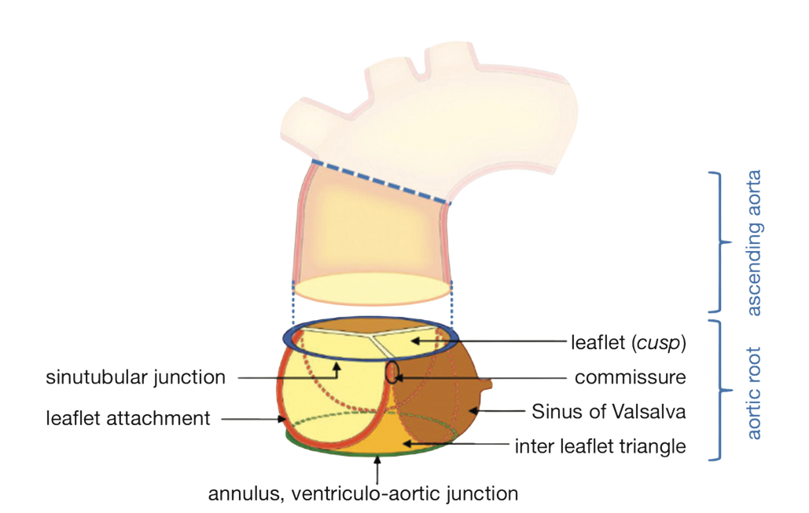
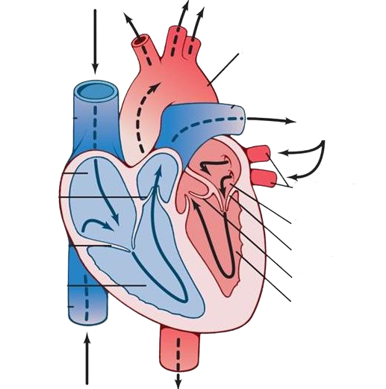

LUCA CAIVANO
OCTOBER 2022
Clinical motivations
World Health Organization
Cardiovascular diseases are one of the major causes of death worldwide (18 millions of victims, 32% of global deaths)
Computational fluid dynamics simulations of blood could help in the understanding of cardiovascular diseases
Aorta
Lungs
Hall, 2015
Pulmonary veins
Left atrium
Mitral valve
Aortic valve
Left ventricle
Charitos and Sievers, Annals of cardiothoracic surgery, 2015
2

Slide 7
LUCA CAIVANO
OCTOBER 2022
Goal of the thesis
Fluid-Structure Interaction problem
REDUCED VALVE MODEL
Increased computational performance
Physical meaning for the parameters
3

Slide 8

LUCA CAIVANO
OCTOBER 2022
Goal of the thesis
Fluid-Structure Interaction problem
REDUCED VALVE MODEL
Increased computational performance
Physical meaning for the parameters
CALIBRATE THE PARAMETERS TO REPRODUCE DIFFERENT PHYSIOLOGICAL SCENARIOS
3

Slide 9
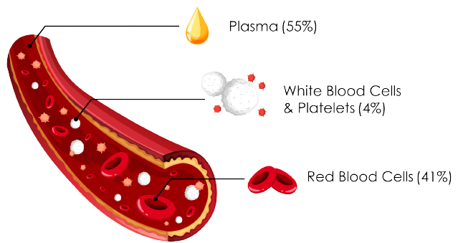
LUCA CAIVANO
OCTOBER 2022
Goal of the thesis
Fluid-Structure Interaction problem
Study of blood's rheology
REDUCED VALVE MODEL
NON-NEWTONIAN MODEL
Increased computational performance
Physical meaning for the parameters
CALIBRATE THE PARAMETERS TO REPRODUCE DIFFERENT PHYSIOLOGICAL SCENARIOS
https://it.depositphotos.com
3

Slide 10
LUCA CAIVANO
OCTOBER 2022
Goal of the thesis
Fluid-Structure Interaction problem
Study of blood's rheology
REDUCED VALVE MODEL
NON-NEWTONIAN MODEL
Increased computational performance
Physical meaning for the parameters
Implementation of the model
Validation of the model
CALIBRATE THE PARAMETERS TO REPRODUCE DIFFERENT PHYSIOLOGICAL SCENARIOS
3

Slide 11

LUCA CAIVANO
OCTOBER 2022
Goal of the thesis
Fluid-Structure Interaction problem
Study of blood's rheology
REDUCED VALVE MODEL
NON-NEWTONIAN MODEL
Increased computational performance
Physical meaning for the parameters
Implementation of the model
Validation of the model
CALIBRATE THE PARAMETERS TO REPRODUCE DIFFERENT PHYSIOLOGICAL SCENARIOS
UNDERSTAND THE EFFECTS OF
NON-NEWTONIAN
RHEOLOGY IN PROXIMITY OF THE AORTIC VALVE
3

Slide 12

OCTOBER 2022
Mathematical models and methods
LUCA CAIVANO

Slide 13
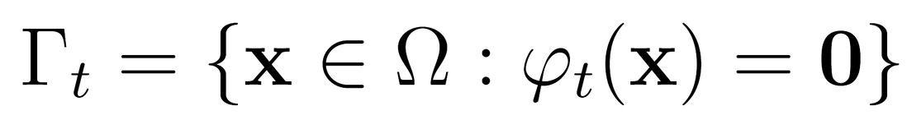
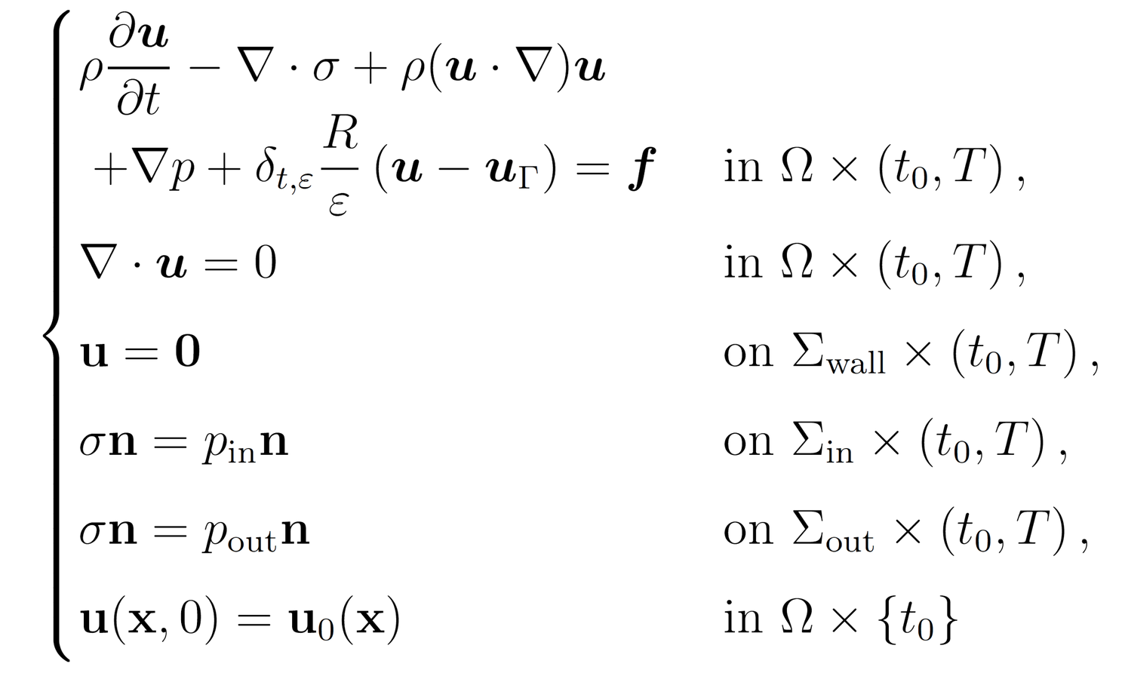
LUCA CAIVANO
OCTOBER 2022
RIIS method
Fedele et al, Biomechanics and modeling in mechanobiology, 2015
Immersed implicit surface
Weak imposition of valve’s velocity
4

Slide 14

LUCA CAIVANO
OCTOBER 2022
RIIS method
Stress tensor
4

Slide 15
LUCA CAIVANO
OCTOBER 2022
RIIS method
Smoothed Dirac delta
4

Slide 16
LUCA CAIVANO
OCTOBER 2022
RIIS method
Leaflets' velocity
4

Slide 17
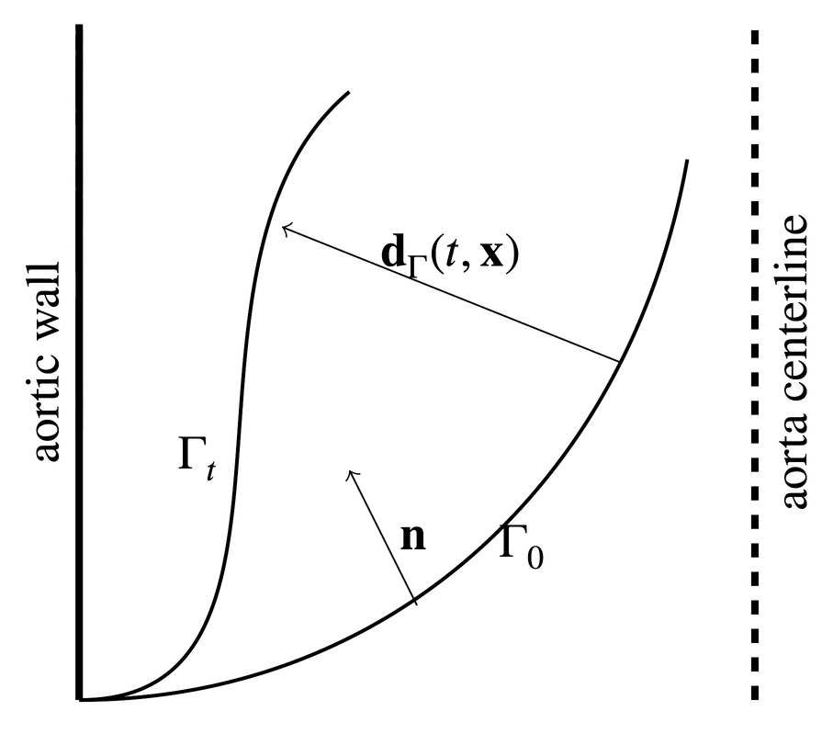
LUCA CAIVANO
OCTOBER 2022
Reduced structure model
Fumagalli, arXiv, 2021
5

Slide 18
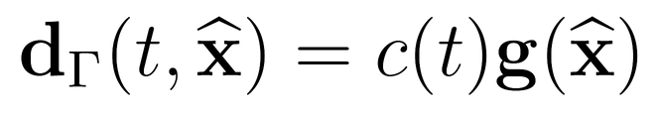
LUCA CAIVANO
OCTOBER 2022
Reduced structure model
Fumagalli, arXiv, 2021
Separation of variables
5

Slide 19
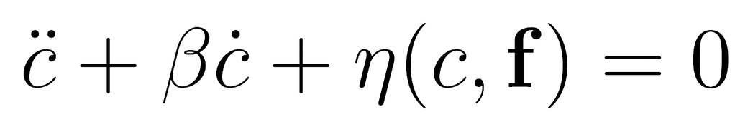
LUCA CAIVANO
OCTOBER 2022
Reduced structure model
Fumagalli, arXiv, 2021
Separation of variables
LOCAL FORCE BALANCE ON THE LEAFLETS
5

Slide 20

LUCA CAIVANO
OCTOBER 2022
Reduced structure model
Fumagalli, arXiv, 2021
Separation of variables
FORCE EXERTED ON THE VALVE
DUE TO THE SURROUNDING FLUID
LOCAL FORCE BALANCE ON THE LEAFLETS
5

Slide 21
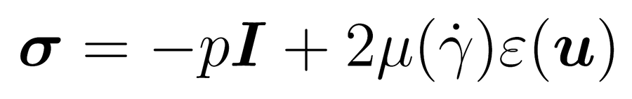
LUCA CAIVANO
OCTOBER 2022
Non-Newtonian model
6

Slide 22
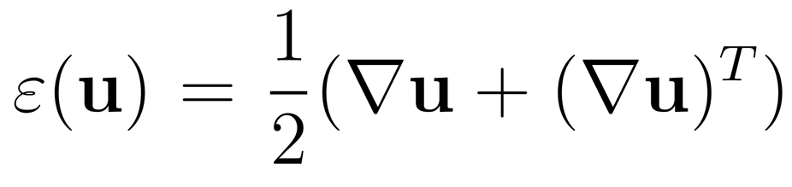
LUCA CAIVANO
OCTOBER 2022
Non-Newtonian model
6

Slide 23
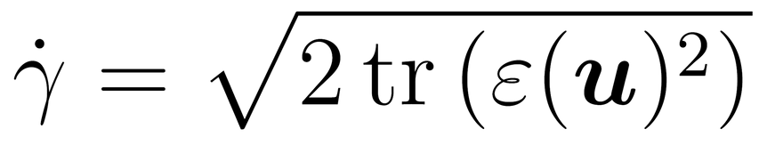
LUCA CAIVANO
OCTOBER 2022
Non-Newtonian model
SHEAR RATE
6

Slide 24
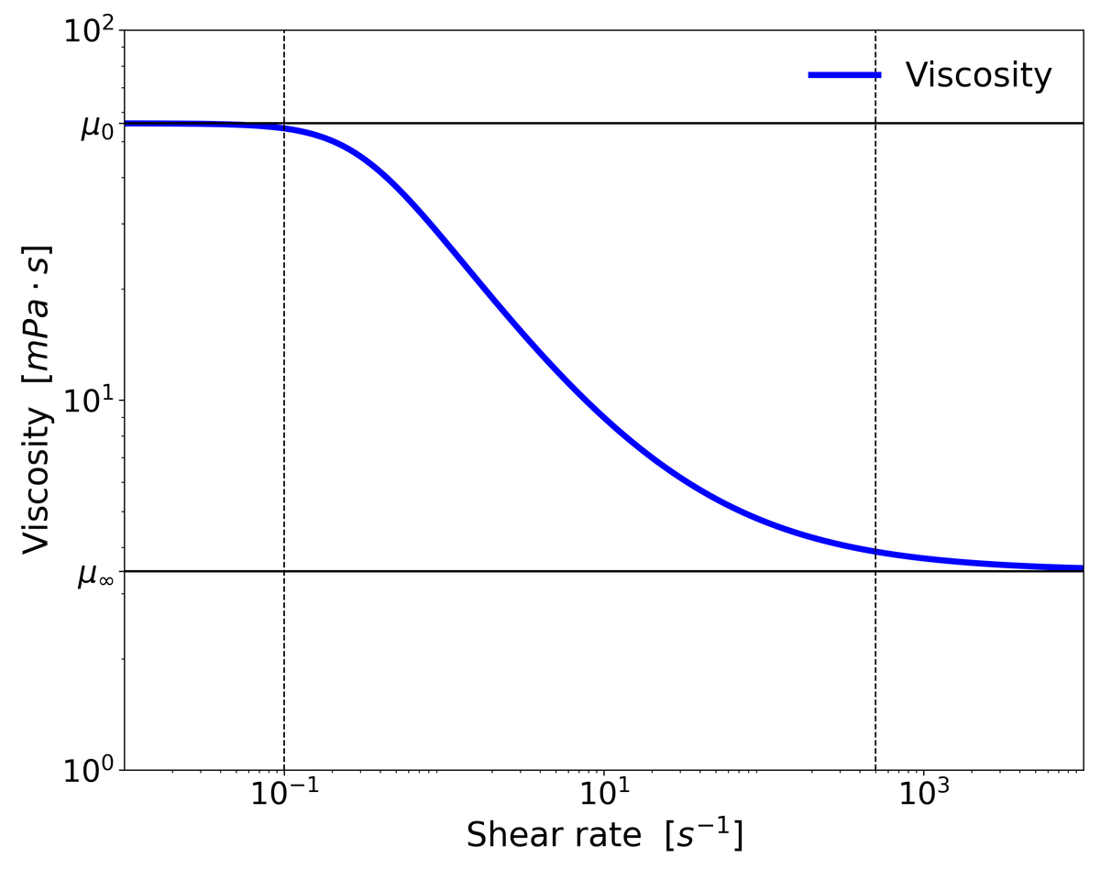
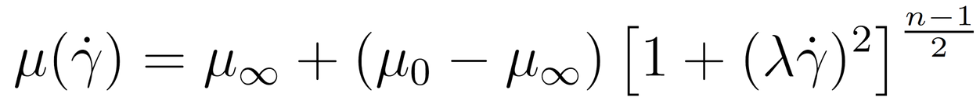
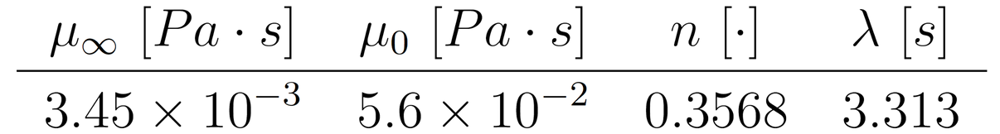
LUCA CAIVANO
OCTOBER 2022
Non-Newtonian model
SHEAR RATE
CARREAU MODEL
Cho and Kensey, Biorheology, 1991
6

Slide 25
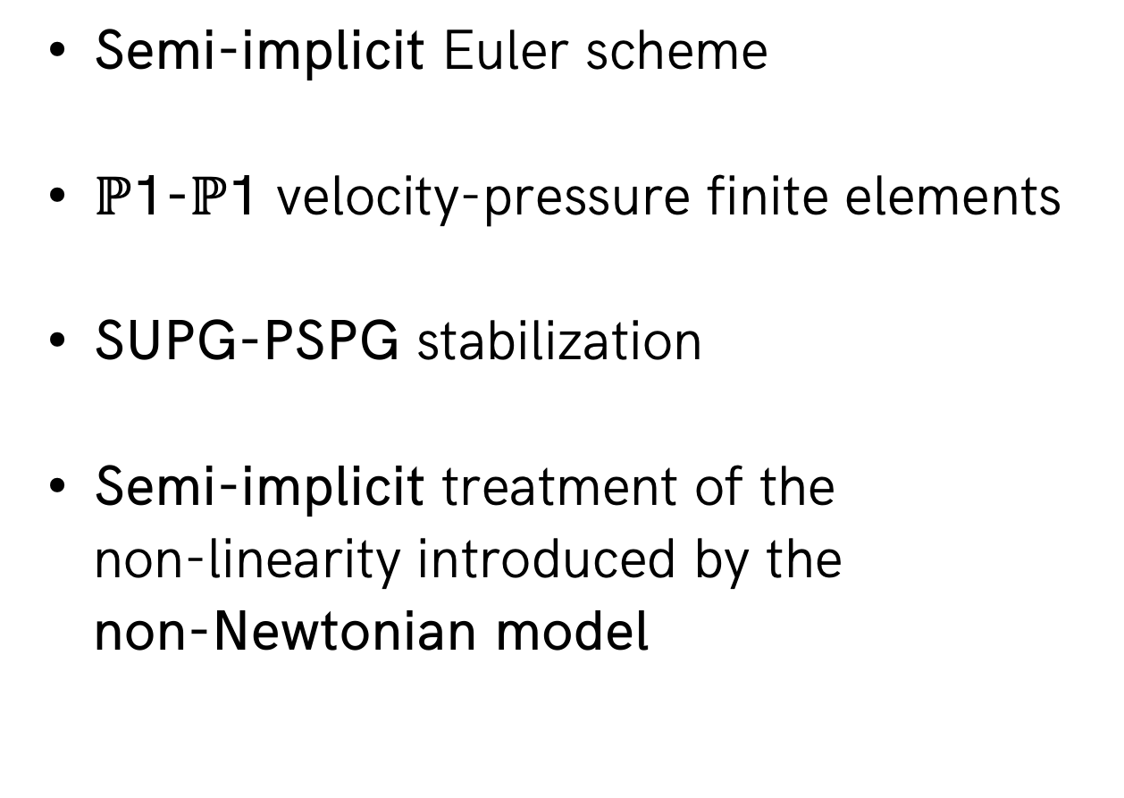
LUCA CAIVANO
OCTOBER 2022
Numerical methods
FLUID
VALVE
Semi-implicit Euler scheme
$ℙ$1-$ℙ$1 velocity-pressure finite elements
SUPG-PSPG stabilization
Semi-implicit treatment of the
non-linearity introduced by the
non-Newtonian model
Explicit Runge-Kutta of the fourth order for the 0D equation
7

Slide 26
LUCA CAIVANO
OCTOBER 2022
Numerical methods
FLUID
VALVE
Semi-implicit Euler scheme
$ℙ$1-$ℙ$1 velocity-pressure finite elements
SUPG-PSPG stabilization
Semi-implicit treatment of the
non-linearity introduced by the
non-Newtonian model
Explicit Runge-Kutta of the fourth order for the 0D equation
FSI: SEGREGATED EXPLICIT COUPLING
7

Slide 27

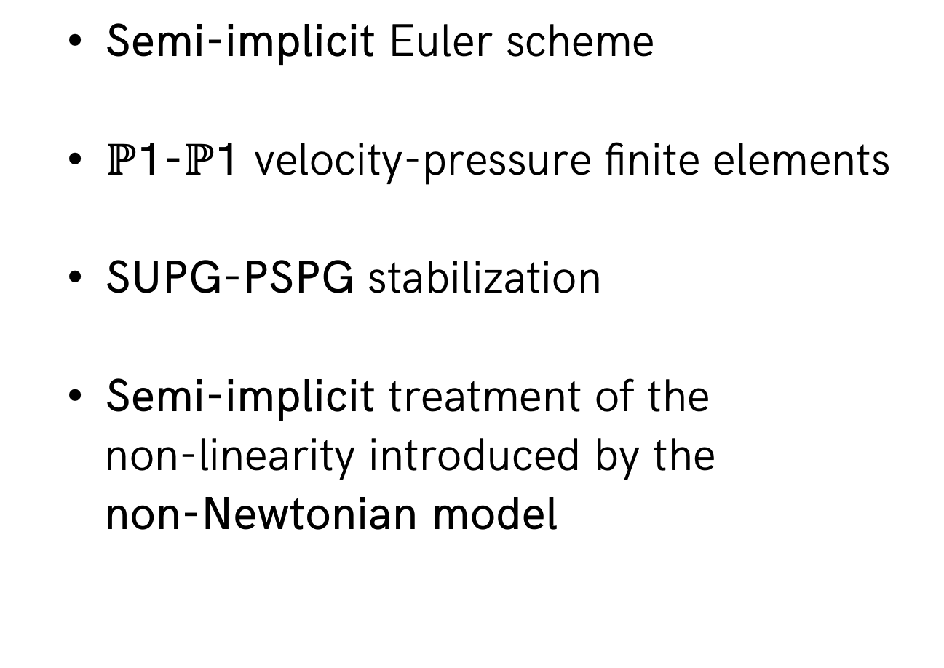
LUCA CAIVANO
OCTOBER 2022
Numerical methods
FLUID
VALVE
Semi-implicit Euler scheme
$ℙ$1-$ℙ$1 velocity-pressure finite elements
SUPG-PSPG stabilization
Semi-implicit treatment of the
non-linearity introduced by the
non-Newtonian model
Explicit Runge-Kutta of the fourth order for the 0D equation
FSI: SEGREGATED EXPLICIT COUPLING
7

Slide 28
OCTOBER 2022
Numerical results
LUCA CAIVANO

Slide 29
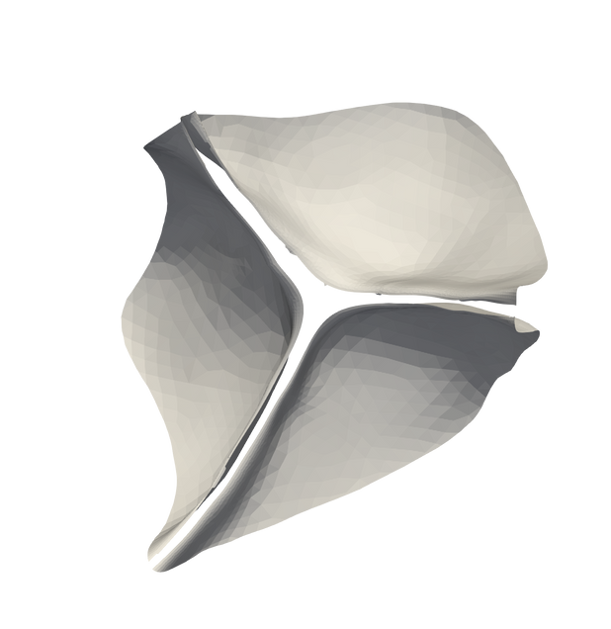
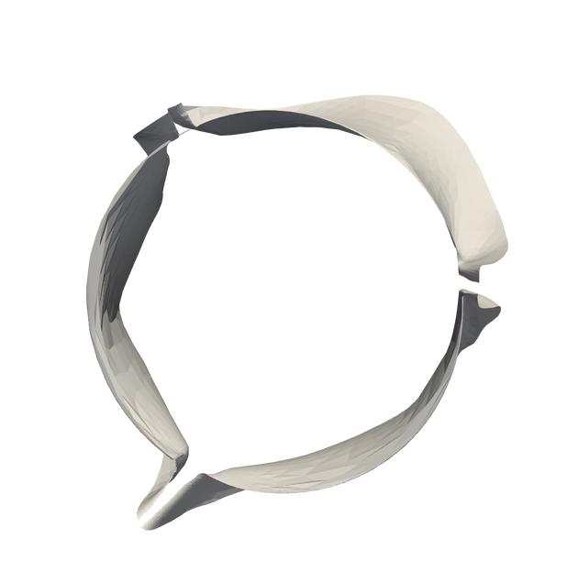
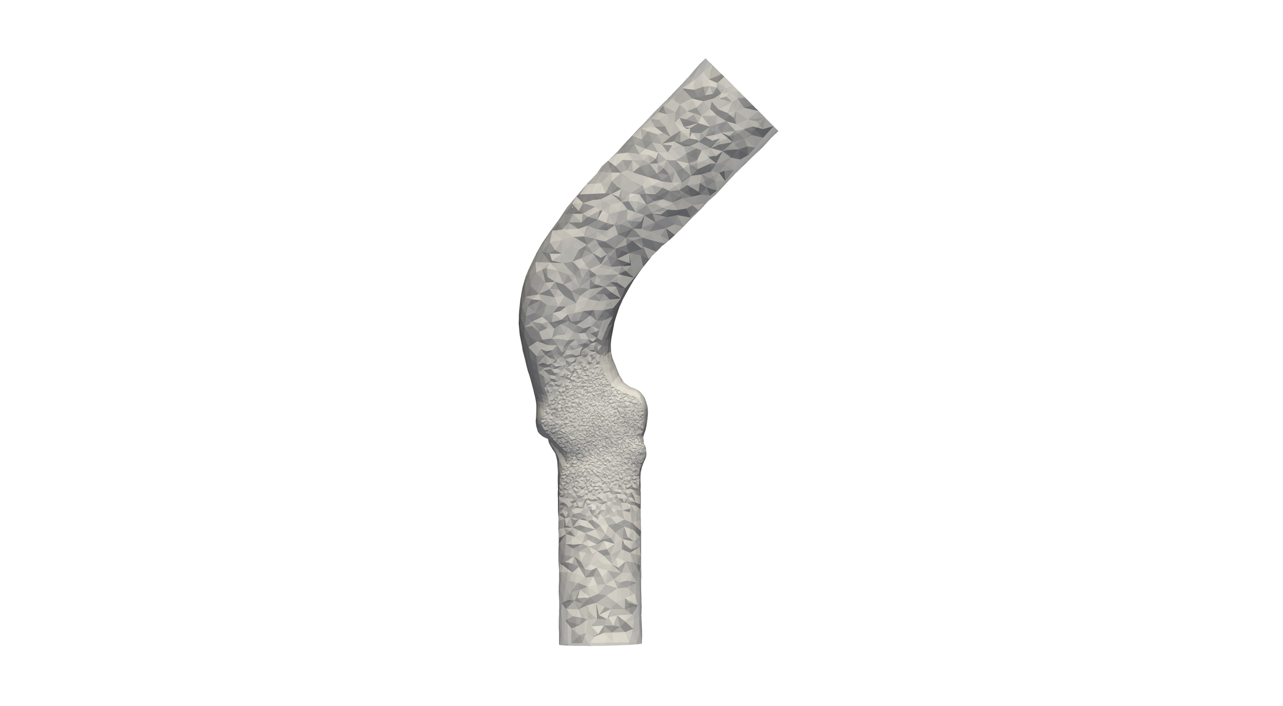
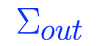

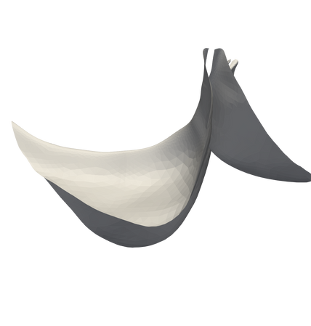
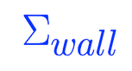
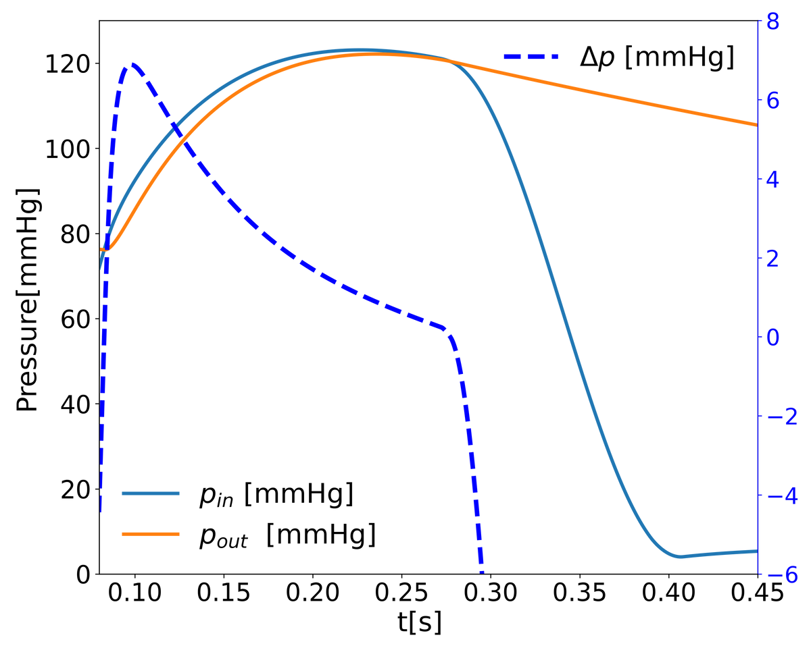
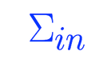
LUCA CAIVANO
OCTOBER 2022
Closed configuration
Open configuration
Numerical setting
Ascending Aorta
Boundary conditions
Aortic valve
leaflets
Flow extension
8

Slide 30
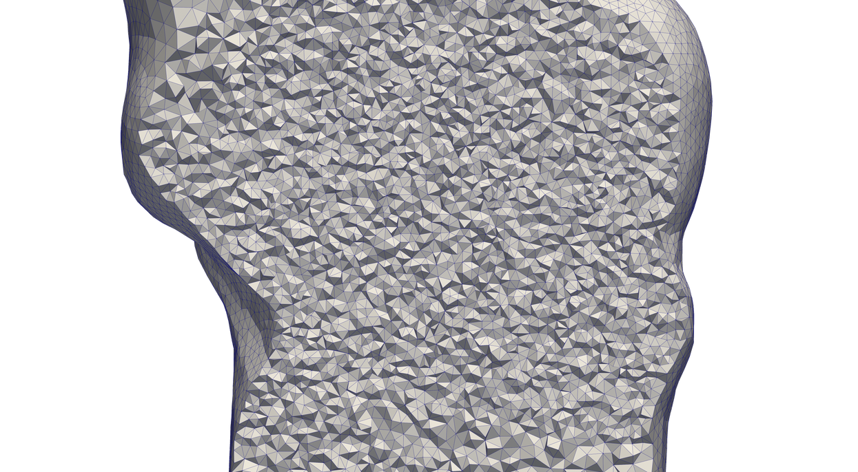

LUCA CAIVANO
OCTOBER 2022
Closed configuration
Open configuration
Numerical setting
Ascending Aorta
Boundary conditions
Aortic valve
leaflets
Flow extension
TOT DOF: 624K
8

Slide 31
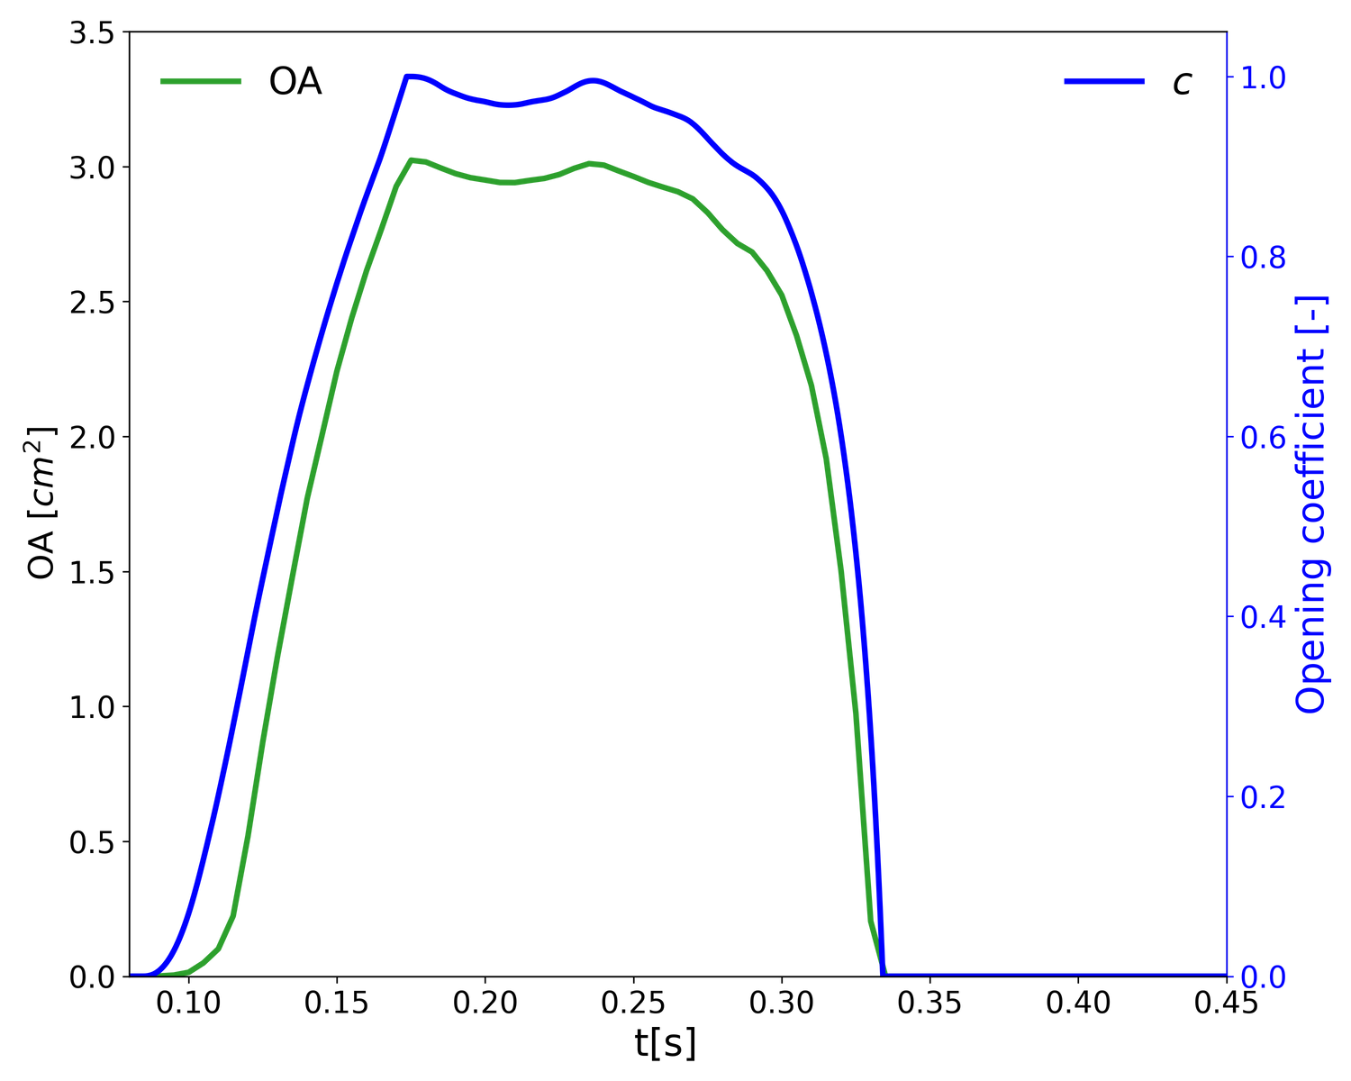

LUCA CAIVANO
OCTOBER 2022
SLOW CLOSURE
Healthy valve
PHYSIOLOGICAL PARAMETERS
Three stages: opening phase, open valve, closing phase
Closing phase: slow and rapid phase
83 ms opening phase (76±30 ms [*])
65 ms closing phase (42±16 ms [*])
[*] Handke et al, The Journal of Thoracic and Cardiovascular Surgery, 2003
OPENING
OPEN
CLOSING
RAPID CLOSURE
9

Slide 32
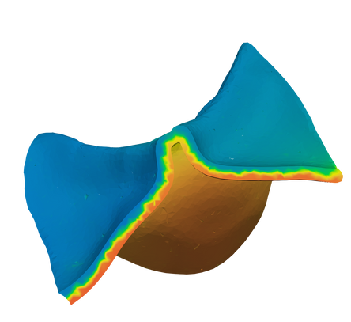
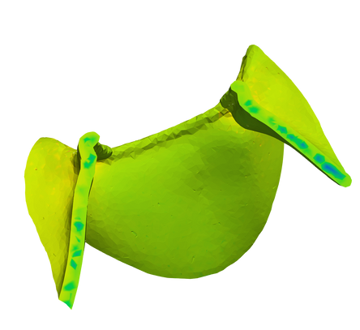
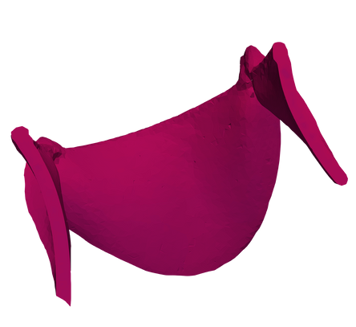
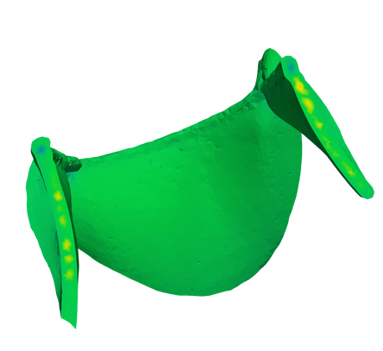
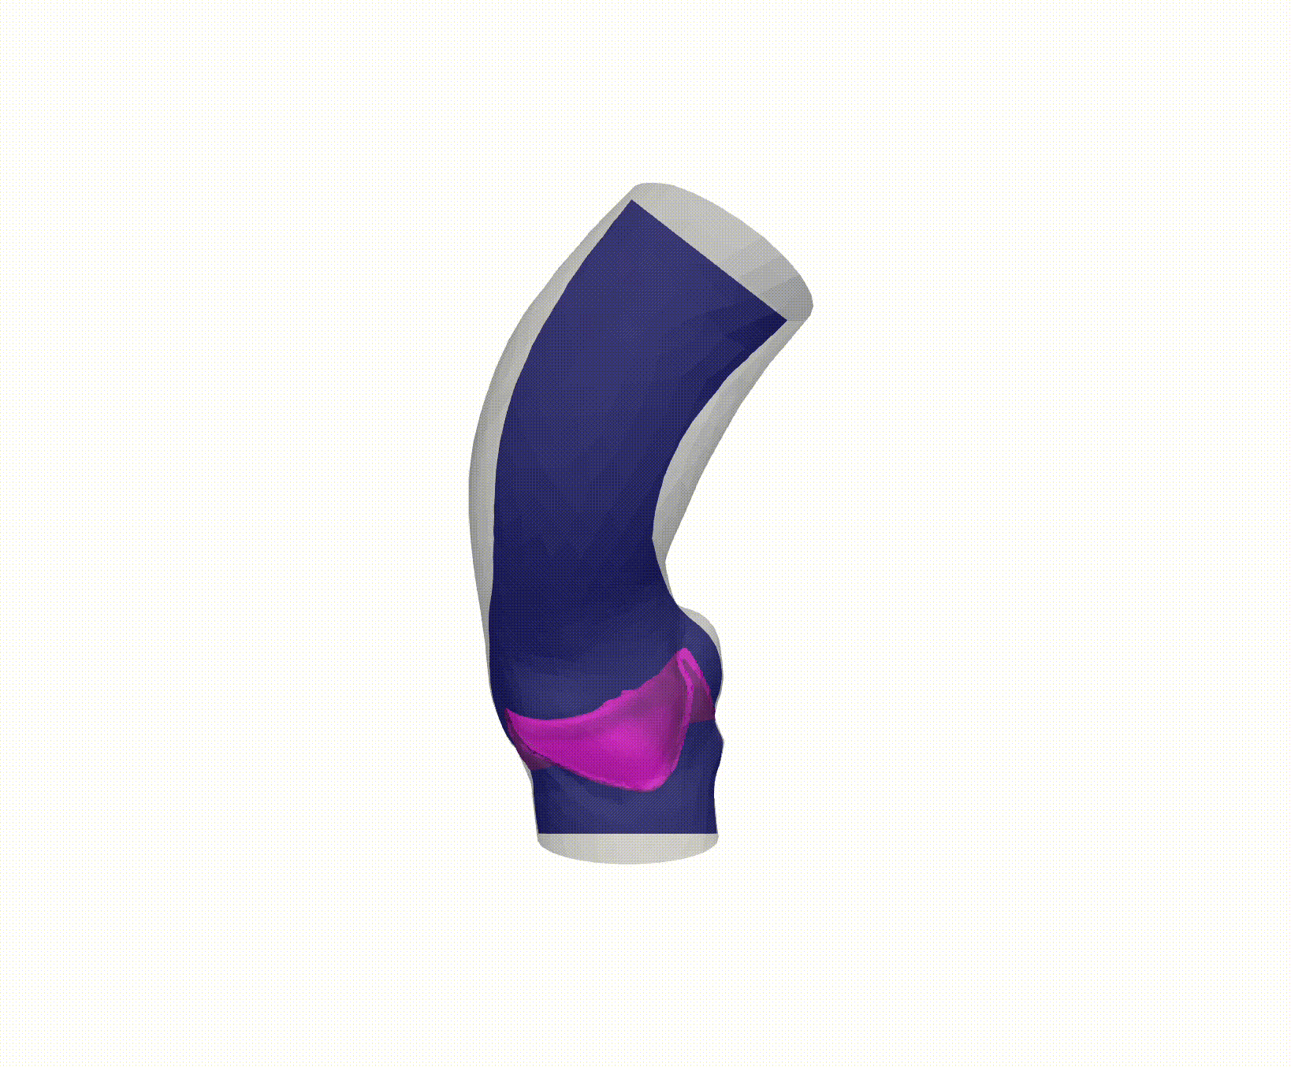
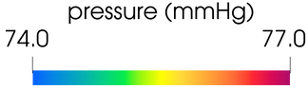
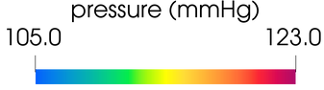
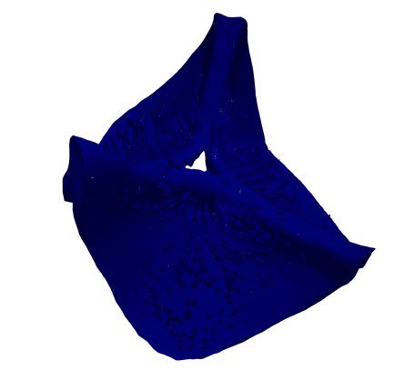
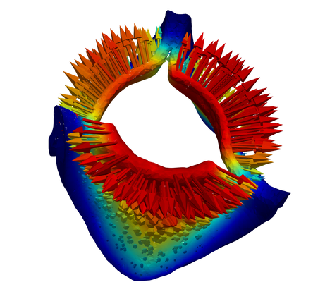
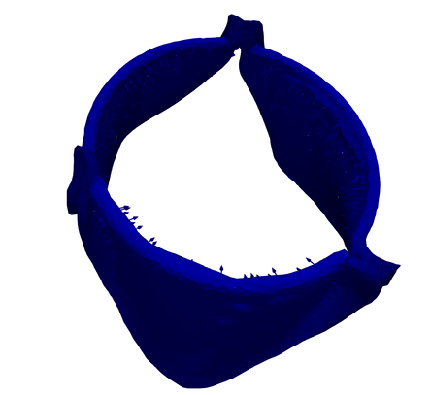
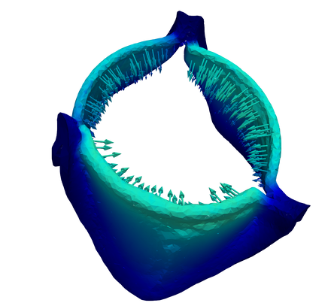
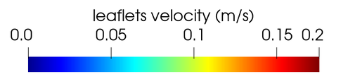
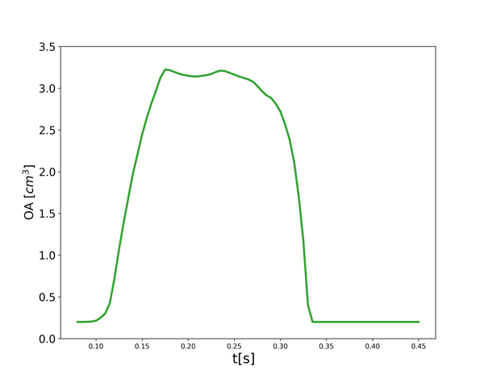

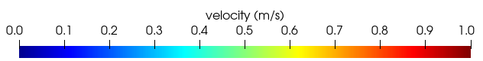
LUCA CAIVANO
OCTOBER 2022
Healthy valve
Valve is closed until 3 mmHg of transvalvular pressure drop develops
During the opening progressive development of aortic jet flow
t=0.085s
t=0.13s
t=0.20s
t=0.30s
10

Slide 33
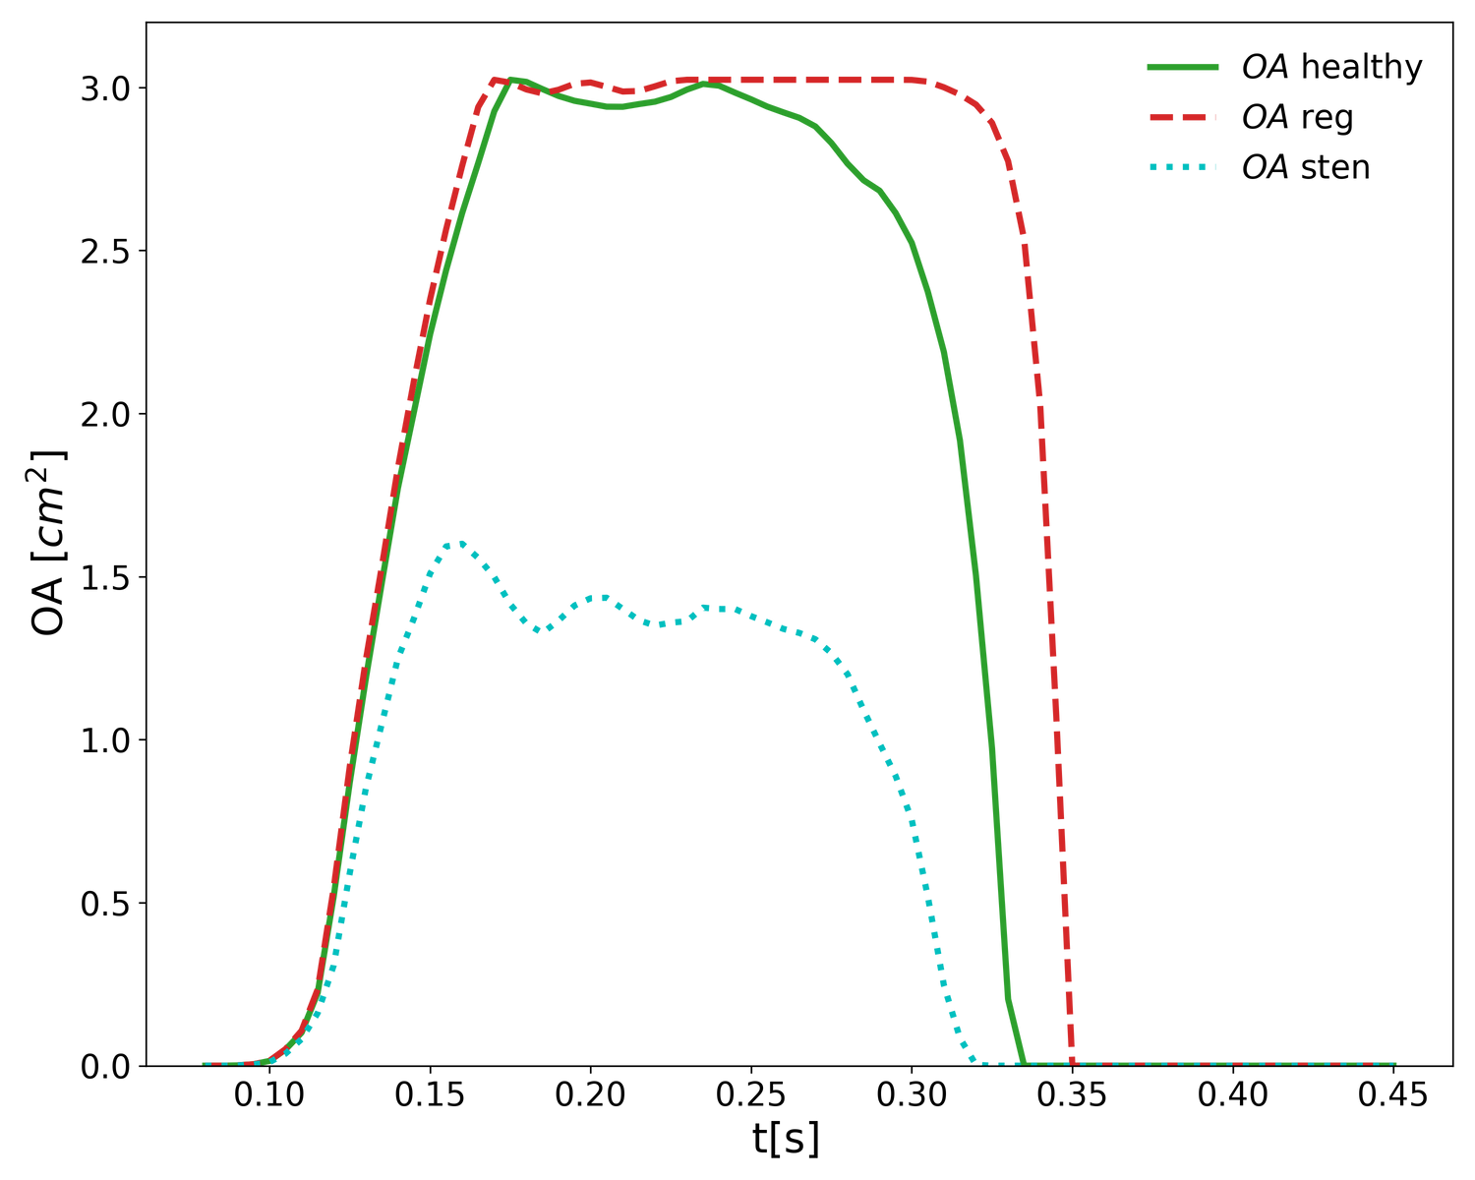
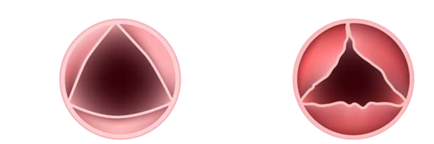
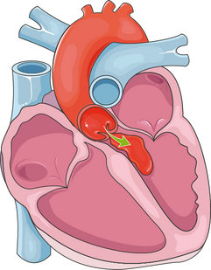
LUCA CAIVANO
OCTOBER 2022
Pathological cases
STENOTIC CASE
Narrowing of the orifice
that limits the anterograde flow through the valve
HEALTHY
STENOTIC
https://www.heart-valve-surgery.com
REGURGITANT CASE
Delayed closing that results in reverse flow occurring while the valve closes
Servier medical art
11

Slide 34
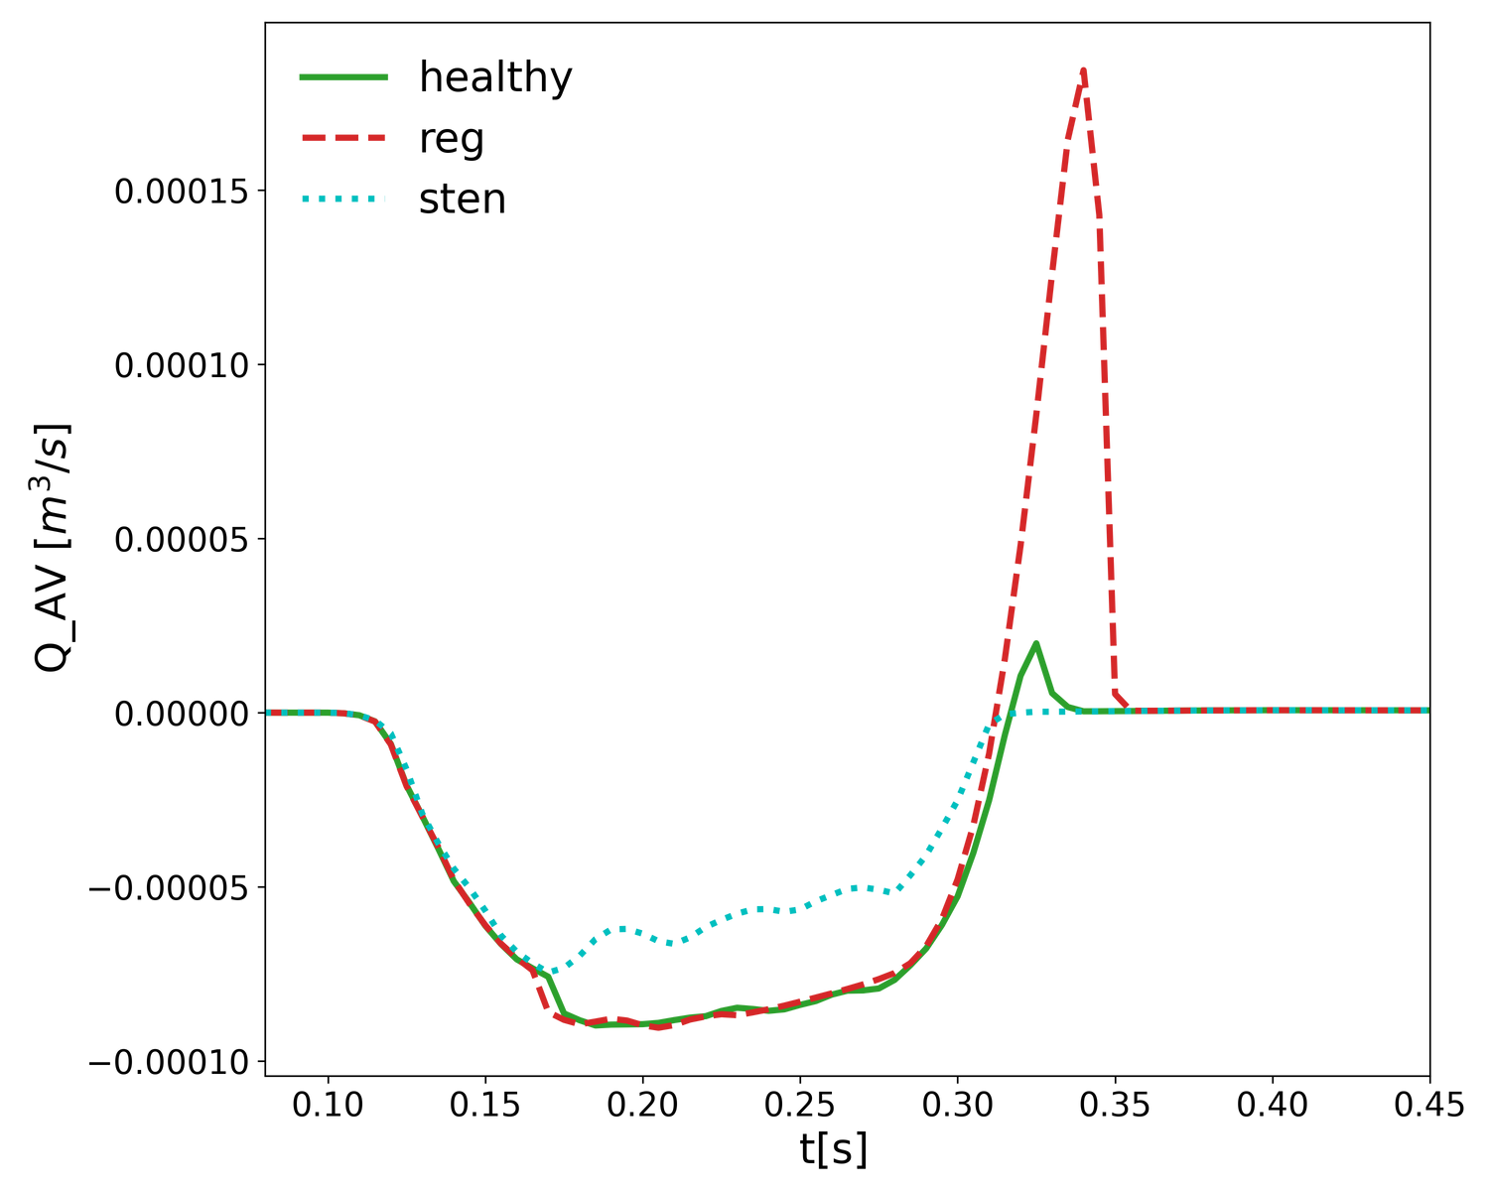
LUCA CAIVANO
OCTOBER 2022
Pathological cases
12

Slide 35
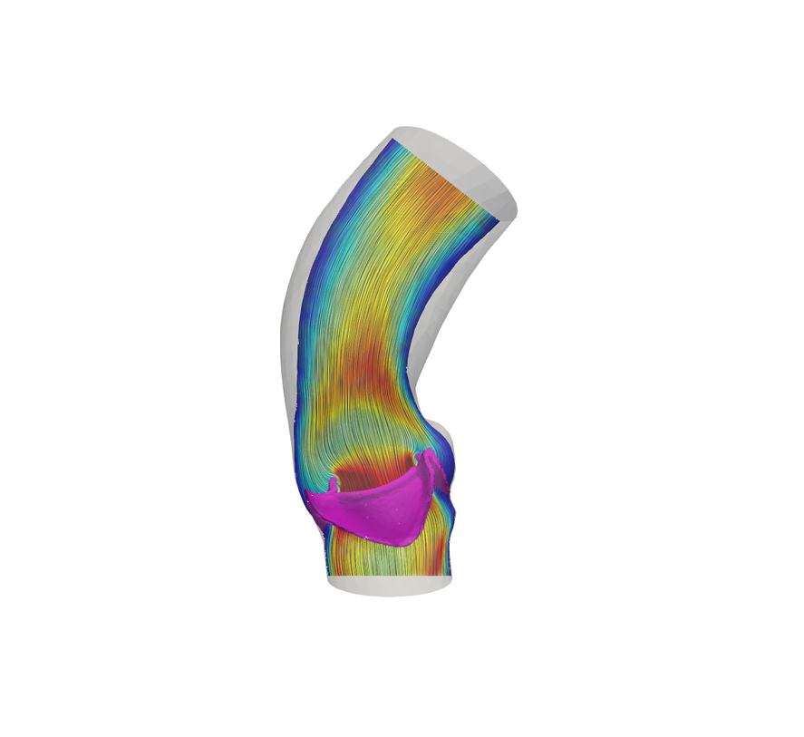
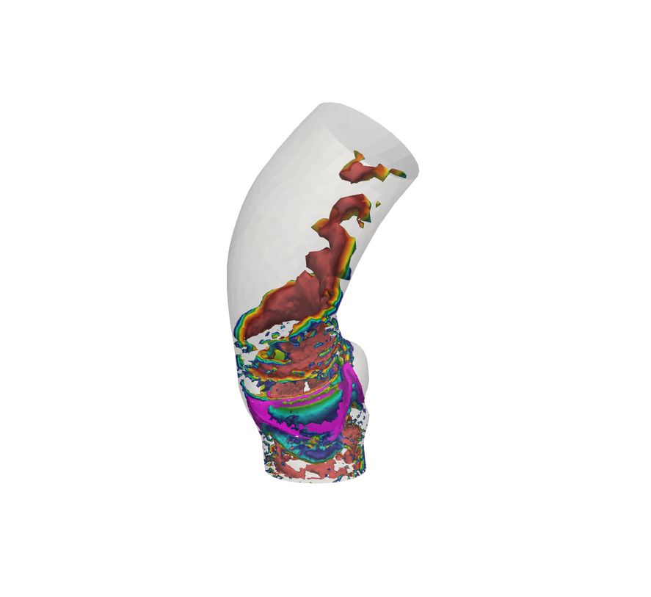

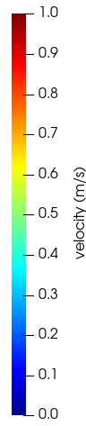
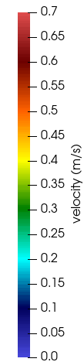
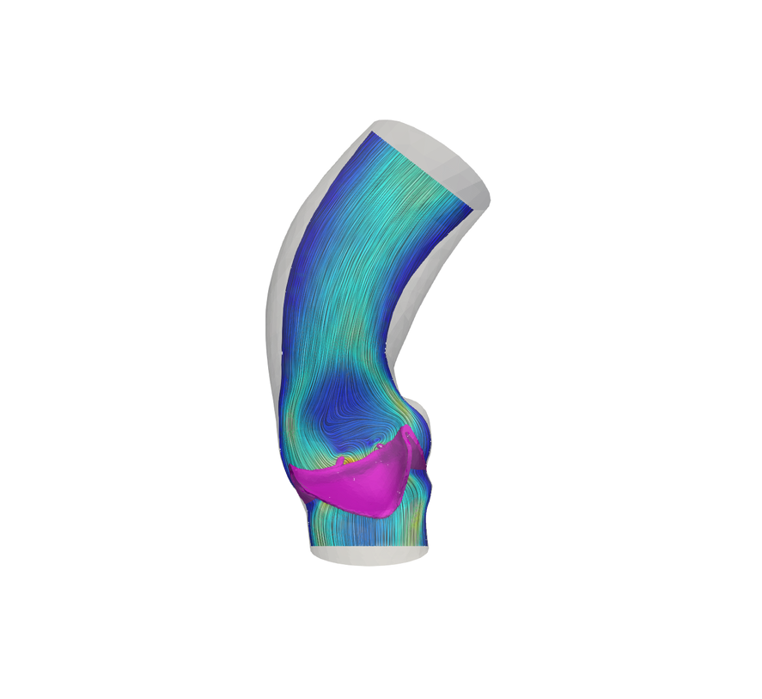
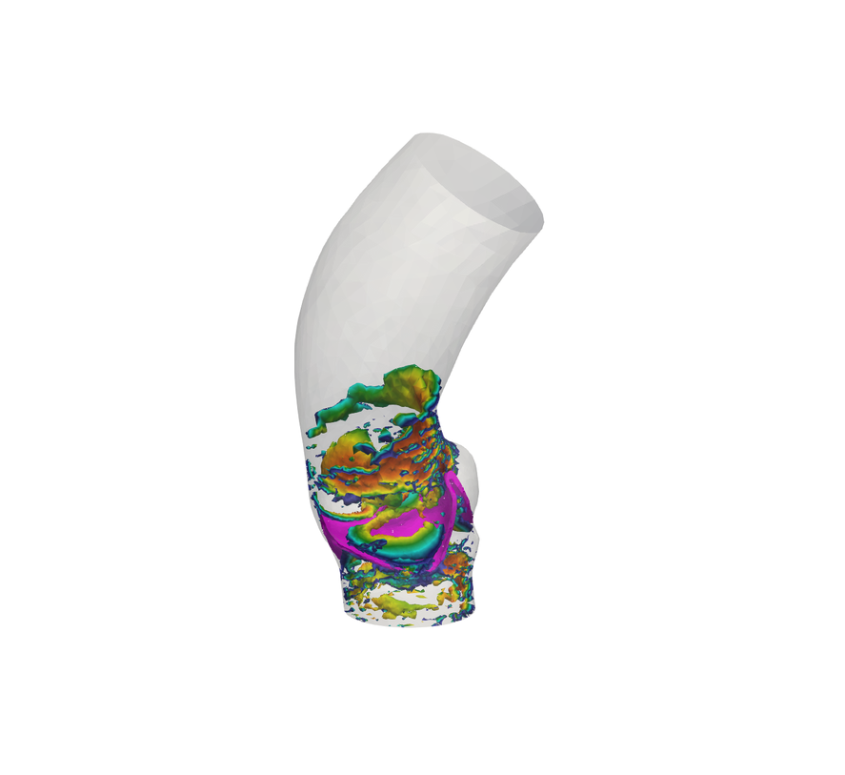

LUCA CAIVANO
OCTOBER 2022
Pathological cases
REGURGITANT
HEALTHY
12

Slide 36





LUCA CAIVANO
OCTOBER 2022
Pathological cases
Stronger aortic jet
More persistent
vortical structures
STENOTIC
HEALTHY
12

Slide 37

LUCA CAIVANO
OCTOBER 2022
Newtonian vs Non-Newtonian
LITTLE INFLUENCE ON:
Valve dynamics
Transvalvular pressure drop
Large flow structures
13

Slide 38








LUCA CAIVANO
OCTOBER 2022
Newtonian vs Non-Newtonian
STENOTIC CASE
NEWTONIAN
NON-NEWTONIAN
NEWTONIAN
NON-NEWTONIAN
CAN INFLUENCE:
t=0.085s
t=0.12s
Atherosclerotic plaques
Wall elasticity
NEWTONIAN
NON-NEWTONIAN
NEWTONIAN
NON-NEWTONIAN
t=0.20s
t=0.29s
14

Slide 39




LUCA CAIVANO
OCTOBER 2022
Newtonian vs Non-Newtonian
SIGNIFICANT DIFFERENCES
STENOTIC CASE
NEWTONIAN
NON-NEWTONIAN
NEWTONIAN
NON-NEWTONIAN
REGURGITANT
STENOTIC
t=0.085s
t=0.12s
NEWTONIAN
NON-NEWTONIAN
NEWTONIAN
NON-NEWTONIAN
t=0.20s
t=0.29s
14

Slide 40

OCTOBER 2022
Conclusions
LUCA CAIVANO

Slide 41
LUCA CAIVANO
OCTOBER 2022
Conclusions
ACHIEVEMENTS
Calibration of the model in different scenarios
15

Slide 42
LUCA CAIVANO
OCTOBER 2022
Conclusions
ACHIEVEMENTS
Calibration of the model in different scenarios
Implementation and validation of the non-Newtonian model
Comparison between rheological models
15

Slide 43

LUCA CAIVANO
OCTOBER 2022
Conclusions
ACHIEVEMENTS
Calibration of the model in different scenarios
Implementation and validation of the non-Newtonian model
Comparison between rheological models
Significant differences observed only on wall shear stress
15

Slide 44
LUCA CAIVANO
OCTOBER 2022
Conclusions
ACHIEVEMENTS
FUTURE DEVELOPMENTS
Calibration of the model in different scenarios
Implementation and validation of the non-Newtonian model
Comparison between rheological models
Investigation of other types of
non-Newtonian models
Inclusion of the left ventricle in the
domain
Account for the compliance of
the aortic wall
Integration of patient-specific data in the computational framework
Significant differences observed only on wall shear stress
15

Slide 45

LUCA CAIVANO
OCTOBER 2022
Thank you
for your attention!

Slide 46
LUCA CAIVANO
OCTOBER 2022
Essential bibliography
Y. I. Cho and K. R. Kensey. Effects of the non-Newtonian viscosity of blood on flows in a diseased arterial vessel. part 1: Steady flows. Biorheology, 1991.
S. Tabakova, E. Nikolova, and S. Radev. Carreau model for oscillatory blood flow in a tube. AIP Conference Proceedings, 2014.
M. Fedele, E. Faggiano, L. Dede, and A. Quarteroni. A patient-specific aortic valve model based on moving resistive immersed implicit surfaces. Biomechanics and modeling in mechanobiology, 2017.
A. Quarteroni, L. Dede’, A. Manzoni, and C. Vergara. Mathematical Modelling of the Human Cardiovascular System: Data, Numerical Approximation, Clinical Applications. Cambridge University Press, 2019.
I. Fumagalli. A reduced 3D-0D FSI model of the aortic valve including leaflets curvature. arXiv, 2021.
P. Africa, R. Piersanti, M. Fedele, L. Dede, and A. Quarteroni. lifex - heart module: a high-performance simulator for the cardiac function - package 1: Fiber generation. arXiv, 2022.

Slide 47

LUCA CAIVANO
OCTOBER 2022
Additional material

Slide 48

LUCA CAIVANO
OCTOBER 2022
Reduced structure model
Leaflets’ curvature
Surface density
Elasticity coefficient
Damping coefficient

Slide 49




LUCA CAIVANO
OCTOBER 2022
Numerical methods
Linear forms
VMS-inspired coefficient
First order approximation

Slide 50

LUCA CAIVANO
OCTOBER 2022
Numerical methods
NUMERICAL SOLUTION SCHEME FOR THE NON-NEWTONIAN 3D-0D FSI MODEL

Slide 51



LUCA CAIVANO
OCTOBER 2022
Validation of the non-Newtonian model
COMPARISON
WITH THE LITERATURE
Semi-analytical procedure
in the reference
Steady and pulsatile pressure gradient for two different radii
STEADY CASE
Tabakova et al, AIP conference proceedings, 2014

Slide 52



LUCA CAIVANO
OCTOBER 2022
Validation of the non-Newtonian model
PULSATILE CASE
MINIMUM FLUX
VELOCITY PROFILE
VISCOSITY DISTRIBUTION

Slide 53




LUCA CAIVANO
OCTOBER 2022
Numerical setting
HEALTHY
STENOTIC
REGURGITANT
8

Slide 54





LUCA CAIVANO
OCTOBER 2022
Healthy valve
t=0.13s
t=0.20s
t=0.28s
t=0.33s

Slide 55







LUCA CAIVANO
OCTOBER 2022
Healthy valve
t=0.085s
t=0.13s
t=0.20s
t=0.30s

Slide 56




LUCA CAIVANO
OCTOBER 2022
Healthy valve: limitation
Reverse flow when the valve should be closed
Geometrical inconsistency
Don't affect the behavior during opening and closing
Possible solution: manually adjust the geometry
t=0.42s

Slide 57










LUCA CAIVANO
OCTOBER 2022
Pathological cases
HEALTHY
STENOTIC
Stronger aortic jet
More persistent
vorticity structures
t=0.13s
t=0.20s
t=0.30s
t=0.13s
t=0.20s
t=0.28s

Slide 58







LUCA CAIVANO
OCTOBER 2022
Newtonian vs Non-Newtonian
REGURGITANT CASE
NEWTONIAN
NON-NEWTONIAN
NEWTONIAN
NON-NEWTONIAN
t=0.085s
t=0.13s
NEWTONIAN
NON-NEWTONIAN
NEWTONIAN
NON-NEWTONIAN
t=0.24s
t=0.34s

Slide 59









LUCA CAIVANO
OCTOBER 2022
Newtonian vs Non-Newtonian
NEWTONIAN
NON-NEWTONIAN
NEWTONIAN
NON-NEWTONIAN
NEWTONIAN
NON-NEWTONIAN
NEWTONIAN
NON-NEWTONIAN
t=0.1s
t=0.13s
t=0.1s
t=0.12s
NEWTONIAN
NON-NEWTONIAN
NEWTONIAN
NON-NEWTONIAN
NEWTONIAN
NON-NEWTONIAN
NEWTONIAN
NON-NEWTONIAN
t=0.24s
t=0.34s
t=0.20s
t=0.29s

Slide 60






LUCA CAIVANO
OCTOBER 2022
Newtonian vs Non-Newtonian
REGURGITANT
REGURGITANT
STENOTIC
STENOTIC
NEWTONIAN
NON-NEWTONIAN

Slide 61




LUCA CAIVANO
OCTOBER 2022
Transvalvular pressure drop
Pathological cases
Control volumes
Newtonian vs non-Newtonian

Slide 62



LUCA CAIVANO
OCTOBER 2022
Anatomy and physiology
Rouleaux aggregation
Cardiac cycle
Stenosis

Slide 63

LUCA CAIVANO
OCTOBER 2022
Sensibility of the healthy configuration

